Slide 1

BRIGHT COFFEE SHOP
ANALYSIS
Data & Business Analytics
CEO Executive Presentation
Turning coffee sales data into decisions, growth and action

Slide 2
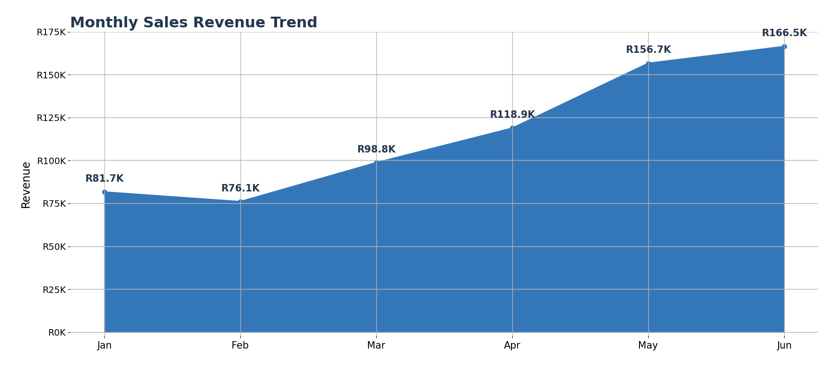
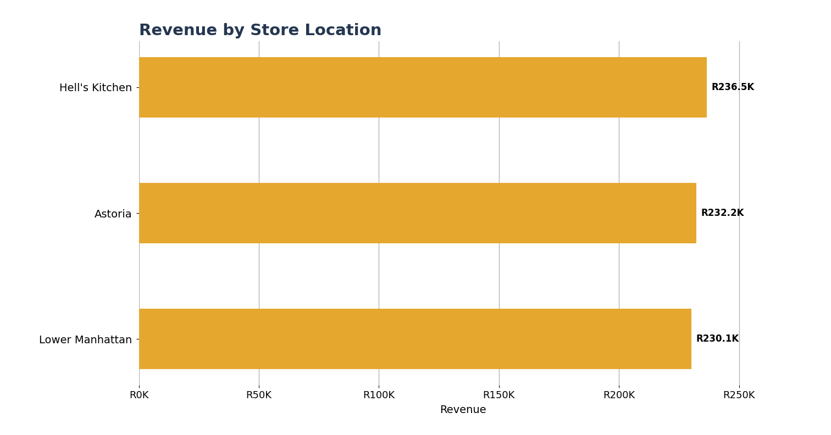
Executive Dashboard
CEO VIEW
TOTAL SALES REVENUE
UNITS SOLD
SALES TRANSACTIONS
STORE LOCATIONS
R698.812
214,470
149,116
3
Headline: Revenue increased from R81.678 in January to R166.486 in June (+103.8%), while performance remained relatively balanced across the three stores.

Slide 3
Data & Analytics Operating Model
END-TO-END WORKFLOW
1
2
3
4
5
6
DATA COLLECTION
→
DATA INGESTION
→
DATABRICKS SQL
→
ANALYSIS
→
PRESENTATION
→
MONITORING
POS transactions captured at source.
ETL moves data into the analytics environment.
Technical inspection, cleaning and transformation.
Excel / analytical work turns data into insights.
PowerPoint / BI communicates the story.
Dashboards support continuous performance tracking.
Technical data inspection in Databricks SQL
Business analyst contribution
• Validated field structure, data types and completeness before analysis.
• Used SQL to filter, aggregate and transform transaction-level data.
• Created analysis-ready datasets for downstream reporting.
• Translated raw transaction data into business questions and KPIs.
• Identified revenue, product, store and time-of-day patterns.
• Converted findings into an executive-ready story and dashboard.

Slide 4
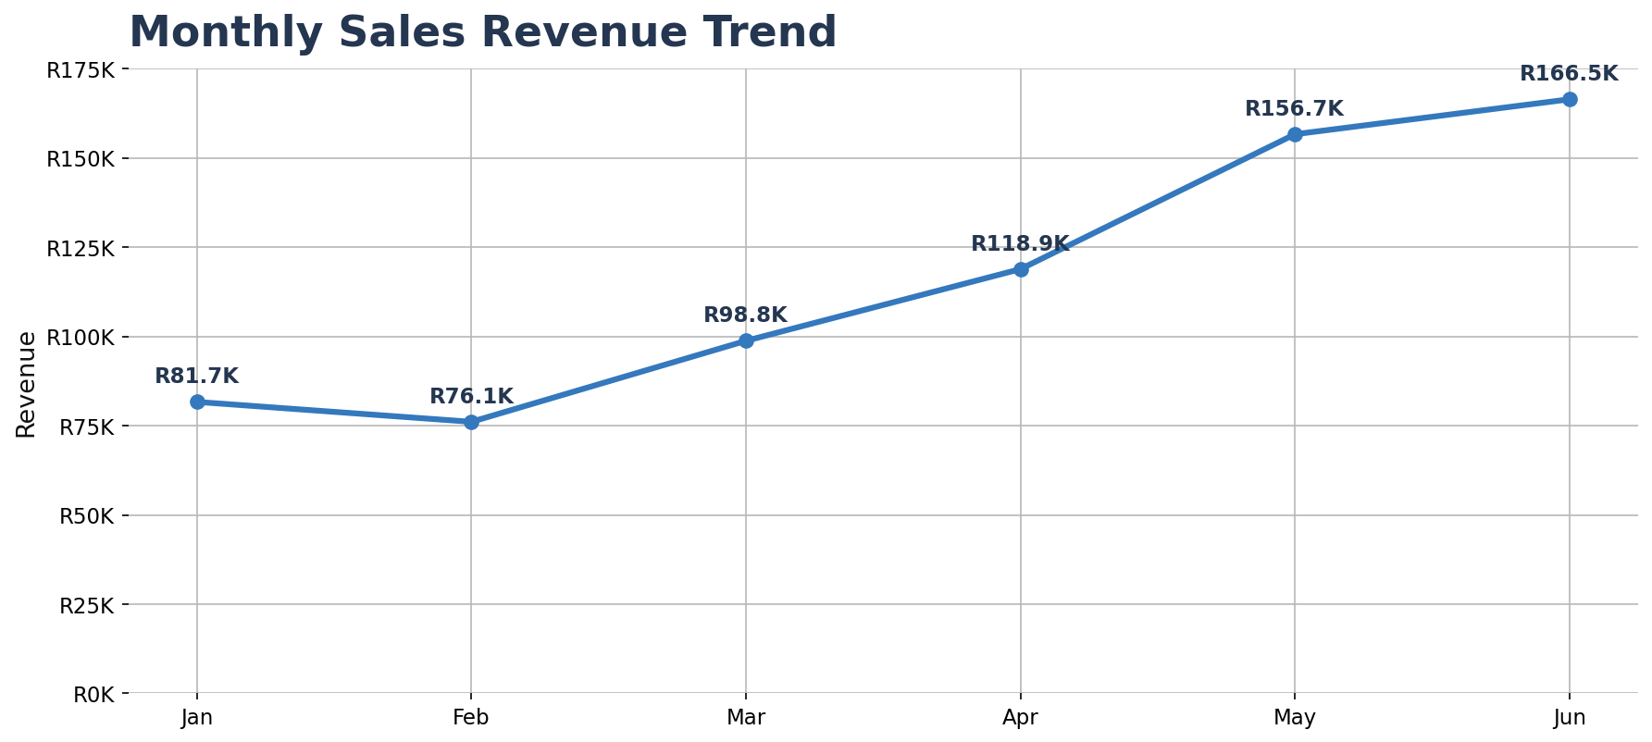
Revenue Performance
TREND ANALYSIS
Executive interpretation
• June delivered the highest monthly revenue at R166.486.
• Revenue grew 103.8% from January to June.
• The strongest acceleration occurred from April through June.
• The pattern indicates positive sales momentum across the period.
Management focus: understand the drivers behind the May–June acceleration and determine which can be sustained.

Slide 5
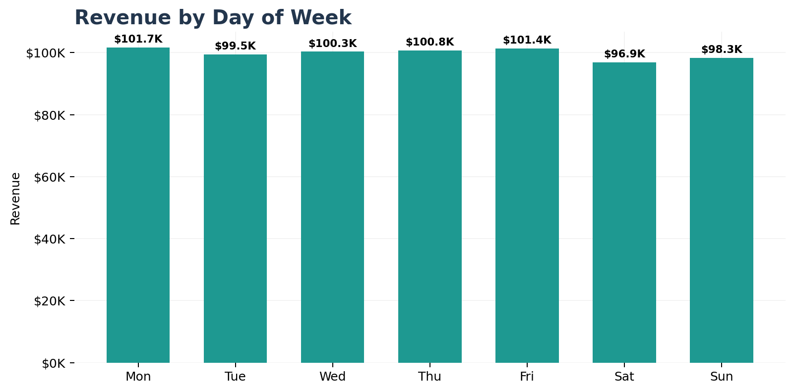
Where Revenue Is Generated
STORE & DAY PERFORMANCE
Store insight: Hell's Kitchen leads at R236.511, but the spread between the three locations is only about R6.454.
Day insight: Monday is the strongest day, while Saturday is the lowest; the overall weekday pattern is relatively stable.

Slide 6
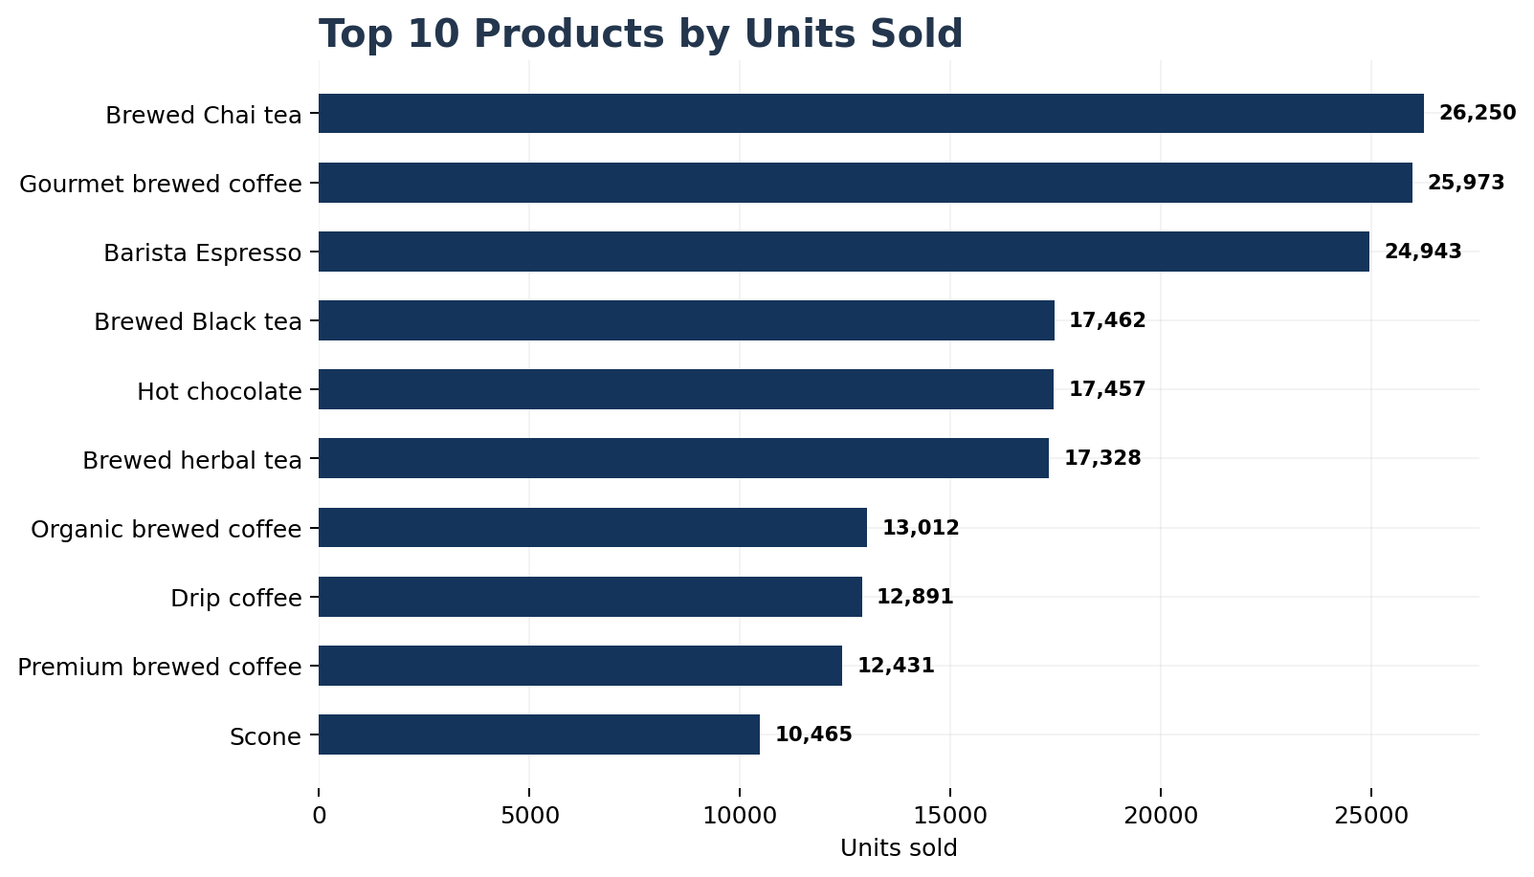
Product Performance
VOLUME & REVENUE DRIVERS
Key product signals
• Brewed Chai tea is the highest-volume product with 26,250 units sold.
• Barista Espresso is the top revenue contributor at R91.406.
• The top 3 volume products account for 36.0% of all units sold.
• Beverage-led products dominate the highest-volume positions, highlighting the importance of the core beverage range.
Management focus: protect availability of high-volume products while assessing margin and cross-sell opportunities.

Slide 7
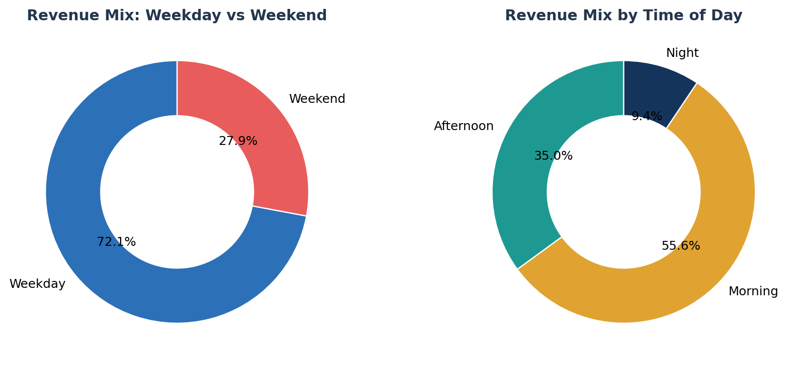
Trading Pattern Insights
WHEN SALES HAPPEN
What the pattern suggests
• Weekdays generate 72.1% of revenue.
• Morning trading contributes 55.6% of revenue.
• Afternoon trading contributes 35.0%.
• Night trading is comparatively small, suggesting a clear opportunity to test targeted evening promotions if operationally viable.
Potential action: align staffing, inventory and promotions with the strongest morning and weekday demand windows.

Slide 8
CEO Dashboard View
ONE-PAGE MANAGEMENT SUMMARY
REVENUE
UNITS
TRANSACTIONS
STORES
JAN → JUN GROWTH
R698.8K
214.5K
149.1K
3
+103.8%

Slide 10
CEO Takeaways & Recommended Next Steps
ACTION
Sustain the growth momentum
01
Investigate the operational and commercial drivers behind the strong May–June revenue acceleration.
Optimise high-volume products
02
Protect availability of leading beverage products and assess pricing, margin and cross-sell opportunities.
Use demand patterns operationally
03
Align staffing, inventory and promotions with strong weekday and morning demand.
Strengthen automated monitoring
04
Move from periodic reporting toward a governed Power BI dashboard with refreshed KPIs and exception alerts.
Closing message: the analysis demonstrates a complete Data & Business Analyst capability — from technical data inspection in Databricks SQL to executive-level decision support.

Slide 11
~
~
~
COFFEE SHOP
SALES & BUSINESS
PERFORMANCE REVIEW
Turning transaction data into decisions that grow revenue, sales and customer value.
PERIOD
REVENUE
TECHNICAL STACK
JAN – JUN 2023
R698.8K
Databricks SQL • BI
Prepared for CEO | Data & Business Analyst

Slide 12
How We Can Grow Revenue & Sales
Recommended commercial actions based on the sales patterns in the analysis.
Increase average order value
Grow morning sales
01
02
Bundle coffee + pastry/snack offers and introduce checkout upselling.
Use breakfast combos and commuter offers during the strongest morning demand window.
Build repeat customers
Target weaker periods
03
04
Introduce a loyalty/rewards programme to increase visit frequency.
Test targeted Saturday/evening promotions instead of broad discounts.
Protect top products
Expand digital sales
05
06
Use demand data to improve availability and inventory planning for high-volume items.
Promote pre-ordering, delivery and office/group coffee orders to create incremental demand.
Coffee Shop Sales Analytics • Data & Business Analyst • Source: Data_Processing.xlsx

Slide 13
CEO Growth Scorecard
Track these KPIs monthly to measure whether growth initiatives are actually working.
Revenue
Transactions
Average order value
R698,812
149,116
R4.69
Total sales value
Number of purchases
Revenue ÷ transactions
Units per transaction
Repeat customer rate
Promotion uplift
1.44
Track
Track
Units ÷ transactions
Requires customer / loyalty ID
Compare campaign vs baseline
Recommended management approach: establish a monthly growth scorecard linking revenue, transaction volume, basket size and customer behaviour to each commercial initiative.
Coffee Shop Sales Analytics • Data & Business Analyst • Source: Data_Processing.xlsx

Slide 14
CONCLUSION
The business generated R698,812 in revenue across 3 stores during the analysis period, with positive momentum toward June and strong demand concentrated in core products.
WHAT THE DATA TELLS US
WHAT THE BUSINESS CAN DO
WHAT THE ANALYST ENABLES
Revenue momentum is positive and the core product range is driving meaningful sales volume.
Grow basket size, strengthen loyalty, target weaker trading periods and protect high-volume products.
Databricks SQL validates and processes the data; analytics converts it into insight and dashboards convert insight into action.
FINAL MESSAGE: The opportunity is not only to report what happened — it is to use data to decide what the coffee business should do next.

